Slide 1



a00s3e3 - DONE
F= -1.77969
F = -1.77893
F= -1.77588, unstable

Slide 2










a00s5e3 - DONE
F = -2.986
F = -2.98574
F = -2.98733
F = -2.98580
F = -2.98637
F = -2.98644

Slide 3


a00s7e3 - DONE
F = -4.20090
F = -4.20224
Terran tried stripe (15.2, 20.2) & (12.2, 20.2). Unstable

Slide 4

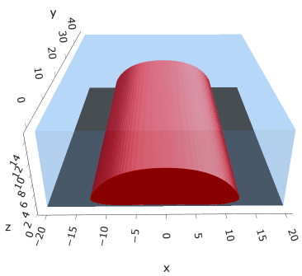

a05s3e3
F = -1.77283
F = -1.77213
F = -1.77005

Slide 5


a05s5e3 - DONE
F = -2.97422
F = -2.97365

Slide 6



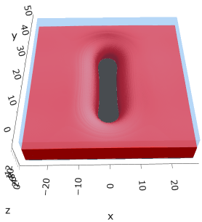

a10s5e3 - DONE
F = -2.93788
F = -2.93873
F = -2.93788

Slide 7
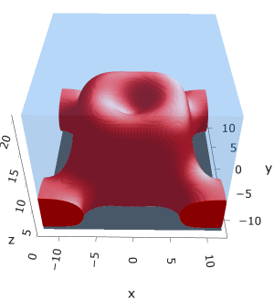
a20s5e3
F = -2.81948

Slide 8
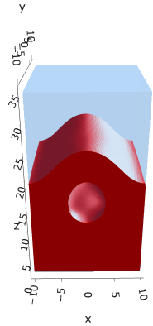
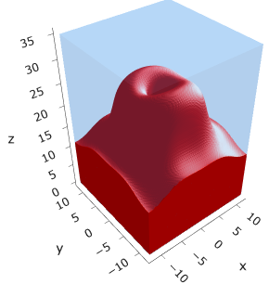
a20s015
F = -8.43694
F = -8.43183

Slide 9

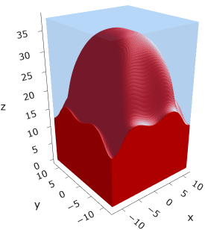
a20s022
F = -12.3420

Slide 10
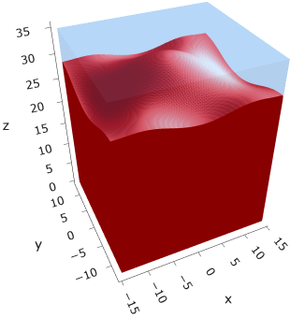
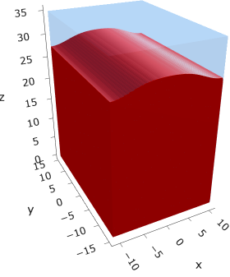

a20s025
F = -14.0024
F = -14.0028
F = -13.9755

Slide 11
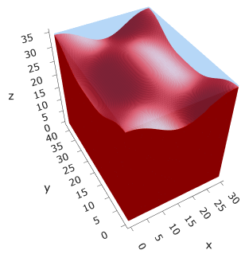



a20s027
F = -15.1046
F = -15.1047
F = -15.0898
F = -15.1050
Note: 2C isomin = 0.50

Slide 12
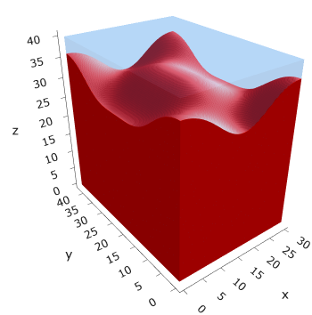
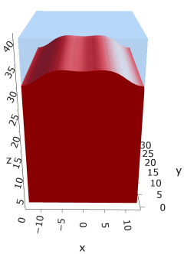

a25s027
F = -14.6053
F = -14.6017
F = -14.6015
Note: 2C isomin = 0.50

Slide 13
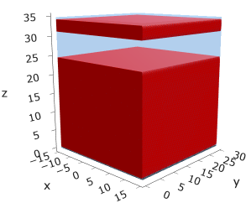
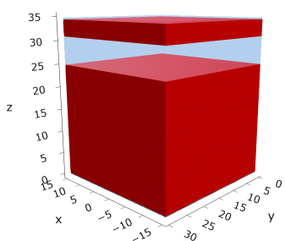
a25
s15
s18

Slide 14





a35
s10
s12
s15
s18

Slide 15



Parallelization
$$α=0, χ=1.25, N=50, σ=0.02$$
$$α=0, χ=1.25, N=200, σ=0.005$$
$$L_{x}=L_{y}=23, { L}_{z}=15$$
Nth = 12: 500 it, 4.3 hrs
Nth = 8 : 500 it, 6.9 hrs
Nth = 6 : 415 it, 20 hrs (poss. mem bottleneck)

Slide 16







Exercise: Micelle / Stripe
s = 5e-03, N = 50, a = 0.0, x = 1.0
s = 5e-03, N = 75, a = 0.0, x = 1.0
Isosurface at pha = 0.1

Slide 17






a040x170s020

Slide 18






a040x170s010

Slide 19

a040x170s025

Slide 20














a040x170s022

Slide 21










a040x170 seed
See if becomes hex
cyl4-975
cyl4-12
cyl16-975
cyl16-1025
cyl1

Slide 22






a040x170s017

Slide 23












































a040x170s015 seed
Almost done
Almost done

Slide 24

















a040x170s013

Slide 25
















a040x170s010 seed

Slide 26














X200 x170 x130 x120 x100
F = −10.24458
F = − 9.14301
F = −11.0057
F = −10.2429
F = −11.0015
F = −9.63949
F = −10.2461
F = −10.9948
F = − 9.63030
F = −10.2431
F = −10.9953

Slide 27





a040x100 relaxation

Slide 28








































a040x100 seed
old
old

Slide 29


a040x120 relaxation
F = −10.24458

Slide 30





































a040x120 seed
cyl16-850
cyl16-825

Slide 31






a040x130 relaxation

Slide 32




a040x170 relaxation
F = −9.10347
1 neck

Slide 33







a040x200 relaxation

Slide 34










a040x200 seed
Note: not completely converged but stopped for resources

Slide 36


a0.40 x1.70

Slide 37





Zhulina JCP 1998
a = 0.01
0.1 mM
1 mM
May need to init using sine
10 mM
25 mM
Zhulina NVT; current GCE runs at Lz = 20

Slide 38

Carrillo Langmuir 2009

Slide 39

Parallelization

Slide 40
Equations
Quenched average, np, A --> \inf ; np/A → \sigma
Discrete Gaussian chain

Slide 41




Scaling (Alexander—de Gennes brush)
V = 4.2; H = 27.5 – 30.5
V = 2; H = 39 – 45.5

Slide 42






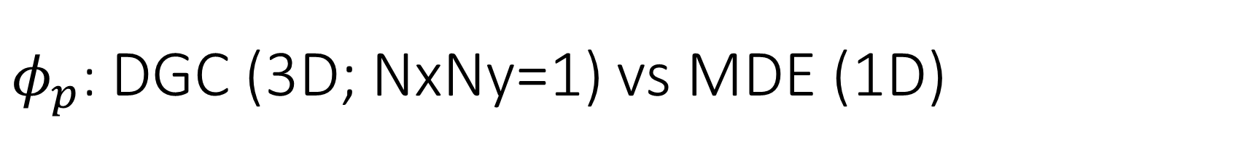
$φ_{p}$: DGC (3D; NxNy=1) vs MDE (1D)
Ns/sigs: dz = 0.10, Ngz_2 = 4$σ$; Chis/bs: dz = 0.25, Ngz_2 = 3.5$σ$

Slide 43


Numericals
Ys
Possibly do Ngz for multiple dzs

Slide 44








3D
Lxy = 1
Lxy = 10
Lxy = 5
Lxy = 15
y-z heatmaps for $φ_{p}$ at constant x

Slide 45





z-FFT vs z-FD (MDE) – REDFT01 xy(z)
Lx = 5, Ly = 5, Lz = 50. s = 0.02. x = 0.75. a = 0.00, N = 50
3D vs 1D (dashed): dz = 0.5, ds = 0.20; dz_1D = 0.113, ds_1D = 0.083
FFT (xyz)
FFT (yz vs pha)
FD (xyz)
FD (yz vs pha)
Diff btw 1D/3D should just be dz, ds, etc.

Slide 46
Specifying Grafted Points

Slide 47
Strategy
2D binary array for surface sites of homogeneously grafted polymer given grafting density, simulation box size, and discretization (and assuming dx = dy)
Fullspace must be periodic on x0 = xL, y0 = yL
Halfspace must be even on xL/2 and yL/2 (overlap of boundary following REDFT00) and periodic on x0 = xL, y0 = yL.
Homogeneous spacing as determined by regular hexagon, where grafting point at centroid of hexagon
In case there are edge effects, try shifting the centroids away from the boundaries of the xy-plane (only did for fullspace)
Make sure no edge effects by comparing results of full FFT with cos FFT

Slide 48
Test conditions
Sigma = 0.05 c/nm2
Lx = 15 nm
Ly = 15 nm
dx = 0.4 nm
Cast in terms of dx (for rounding and PBC for grafting points):
Sigma = 0.0668 c/nm2
Lx = 14.80 nm
Ly = 11.20 nm
(Sigma error decrease with dx)

Slide 49

Padded PBC (Full FFT)
Hexagons drawn for illustration of hexagon approach

Slide 50

Unpadded PBC (Full/Cos FFT)

Slide 51






Other conditions (full and half results overlapped to show match)
s = 0.0241 (20.28%; dx=0.4), Lx, Ly = 12.40, 20.80
s = 0.0208 (4.08%; dx=0.1), Lx, Ly = 12.90, 22.30
s = 0.1332 (11%; dx=0.1), Lx, Ly = 20.50, 20.40

Slide 52


